Slide 1

Information Security Engr. Syed Rizwan

Slide 2
The Substitution Ciphers
The Playfair Cipher
The Playfair cipher was the first practical digraph (pair of alphabets) substitution cipher.
The scheme was invented in 1854 by Charles Wheatstone but was named after Lord Playfair who promoted the use of the cipher.

Slide 3
The Substitution Ciphers
The Playfair Cipher
The Playfair algorithm is based on the use of a 5×5 matrix of letters constructed using a keyword.
If the keyword is monarchy. The matrix is constructed by filling in the letters of the keyword (minus duplicates) from left to right and from top to bottom, and then filling in the remainder of the matrix with the remaining letters in alphabetic order.
The letters I and J count as one letter (Normally J is omitted).

Slide 4
The Substitution Ciphers
The Playfair Cipher
M | O | N | A | R
C | H | Y | B | D
E | F | G | I/J | K
L | P | Q | S | T
U | V | W | X | Z

Slide 5
The Substitution Ciphers
The Playfair Cipher
Plaintext is encrypted two letters at a time, according to the following rules:
Repeating plaintext letters that are in the same pair are separated with a filler letter, such as x, so that balloon would be treated as ba lx lo on.
x (sometime z) is also used to fill second letter in the digram if there is an odd number of letter.
Two plaintext letters that fall in the same row of the matrix are each replaced by the letter to the right, with the first element of the row circularly following the last. For example, AR is encrypted as RM.

Slide 6
The Substitution Ciphers
The Playfair Cipher
Plaintext is encrypted two letters at a time, according to the following rules:
Two plaintext letters that fall in the same column are each replaced by the letter beneath, with the top element of the column circularly following the last. For example, MU is encrypted as CM.
Otherwise, each plaintext letter in a pair is replaced by the letter that lies in its own row and the column occupied by the other plaintext letter. Thus, HS becomes BP and EA becomes IM (or JM, as the encipherer wishes).

Slide 7
The Substitution Ciphers
The Playfair Cipher
If keyword is Monarchy and
plaintext is Instruments
Then first break the plaintext is converted into cipher text as follows:
M | O | N | A | R
C | H | Y | B | D
E | F | G | I/J | K
L | P | Q | S | T
U | V | W | X | Z
Plaintext | in | st | ru | me | nt | sx
Ciphertext | GA | TL | MZ | CL | RQ | XA

Slide 8
The Substitution Ciphers
The Hill Cipher
Hill cipher invented by Lester S. Hill in 1929.
It is the first polygraphic cipher in which it was practical (though barely) to operate on more than three symbols at once.
Each letter is represented by a number modulo 26.
Often the simple scheme A = 0, B = 1, …, Z = 25 is used, but this is not an essential feature of the cipher.

Slide 9
The Substitution Ciphers
The Hill Cipher
To encrypt a message, each block of n letters (considered as an n-component vector) is multiplied by an invertible nxn matrix, against modulus 26. To decrypt the message, each block is multiplied by the inverse of the matrix used for encryption.

Slide 10


The Substitution Ciphers
The Hill Cipher
Suppose we have to encrypt the message ‘act’ (n=3).The key is ‘gybnqkurp’ which can be written as the n x n matrix:
$$\left[\begin{aligned}&6 24 1 \\ &13 16 10 \\ &20 17 15\end{aligned}\right]$$
$$\left[\begin{aligned}& 0 \\ & 2 \\ &19\end{aligned}\right]$$
gybnqkurp
act

Slide 11
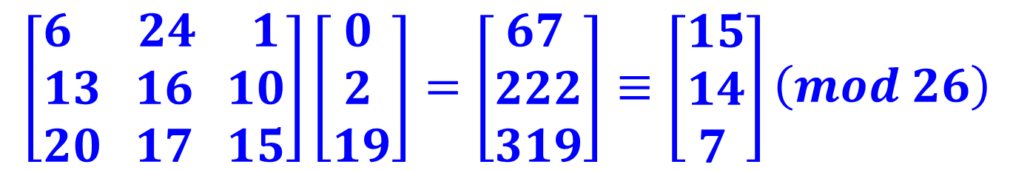
The Substitution Ciphers
The Hill Cipher
Encryption
$$\left[\begin{aligned}&6 24 1 \\ &13 16 10 \\ &20 17 15\end{aligned}\right]\left[\begin{aligned}& 0 \\ & 2 \\ &19\end{aligned}\right]=\left[\begin{aligned}& 67 \\ &222 \\ &319\end{aligned}\right]≡\left[\begin{aligned}&15 \\ &14 \\ & 7\end{aligned}\right]\left(mod 26\right)$$
gybnqkurp
act
POH

Slide 12

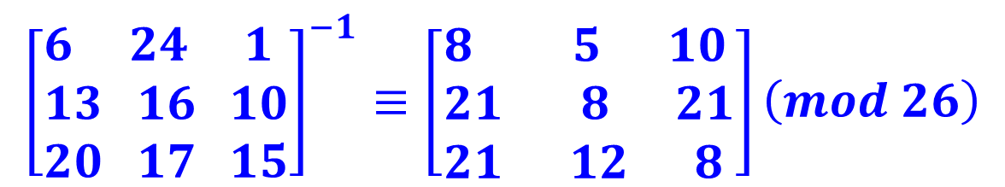
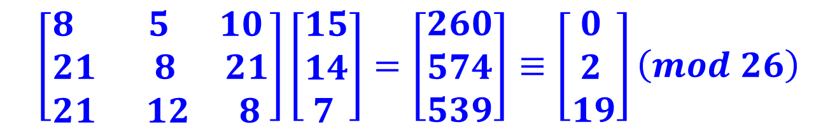
The Substitution Ciphers
The Hill Cipher
Decryption
$${\left[\begin{aligned}&6 24 1 \\ &13 16 10 \\ &20 17 15\end{aligned}\right]}^{−1}≡\left[\begin{aligned}&8 5 10 \\ &21 8 21 \\ &21 12 8\end{aligned}\right]\left(mod 26\right)$$
$${\left(\text{gybnqkurp}\right)}^{−1}$$
$$\left[\begin{aligned}&8 5 10 \\ &21 8 21 \\ &21 12 8\end{aligned}\right]\left[\begin{aligned}&15 \\ &14 \\ & 7\end{aligned}\right]=\left[\begin{aligned}&260 \\ &574 \\ &539\end{aligned}\right]≡\left[\begin{aligned}& 0 \\ & 2 \\ &19\end{aligned}\right]\left(mod 26\right)$$
POH
act

Slide 13
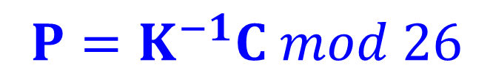
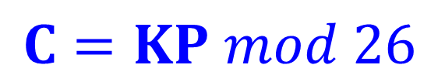
The Substitution Ciphers
The Hill Cipher
To conclude this Hill Cipher
where C and P are column vectors of n values representing Ciphertext and Plaintext and K is n x n matrix represents the key
$$C=KP mod 26$$
$$P=K^{−1}C mod 26$$

Slide 14
The Substitution Ciphers
The Vigenère Cipher
Vigenère Cipher is a method of encrypting alphabetic text. It uses a simple form of polyalphabetic substitution.
A polyalphabetic cipher is any cipher based on substitution, using multiple substitution alphabets. The encryption of the original text is done using the Vigenère square or Vigenère table.

Slide 15
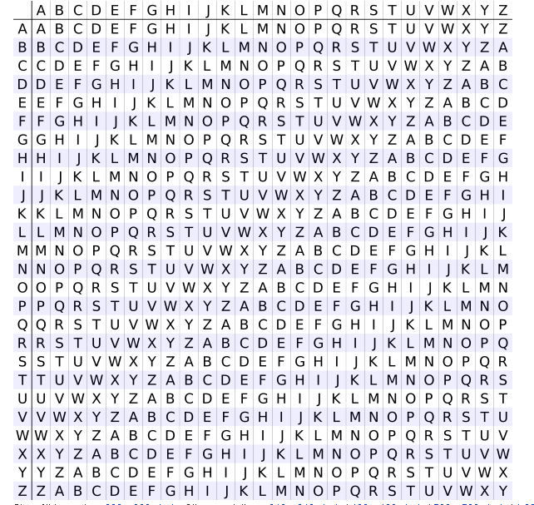
The Substitution Ciphers
The Vigenère Cipher
Vigenère Square
or
Vigenère table.

Slide 16
The Substitution Ciphers
The Vigenère Cipher
The table consists of the alphabets written out 26 times in different rows, each alphabet shifted cyclically to the left compared to the previous alphabet.
At different points in the encryption process, the cipher uses a different alphabet from one of the rows.
The alphabet used at each point depends on a repeating keyword.

Slide 17
The Substitution Ciphers
The Vigenère Cipher (Example)
Plaintext : geeks for geeks
Keyword : ayush
Ciphertext : GCYCZFMLYLEIM
For generating key, the given keyword is repeated in a circular manner until it matches the length of the plain text.
The keyword "ayush" generates the key "ayushayushayu"
The plain text is then encrypted using the process explained below.

Slide 18
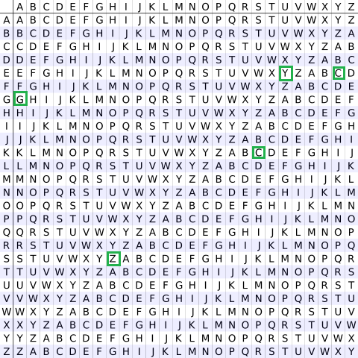
The Substitution Ciphers
The Vigenère Cipher (Example)
Keyword
Encryption
Process
Vigenère square or Vigenère table.
Plaintext
Ciphertext

Slide 19
The Substitution Ciphers
The Vigenère Cipher (Example)
Plaintext
Decryption
Process
Keyword
Vigenère square or Vigenère table.
Ciphertext

Slide 20
The Substitution Ciphers
The Vernam Cipher (One time pad)
In Vernam Cipher we assign a number to each character of the Plain-Text, like (a = 0, b = 1, c = 2, … z = 25).
We take a key to encrypt the plain text which length should be equal to the length of the plain text.

Slide 21
The Substitution Ciphers
The Vernam Cipher (One time pad)
Assign a number to each character of the plain-text and the key according to alphabetical order.
Add both the number (Corresponding plain-text character number and Key character number).
Subtract 26 from the number if the added number is greater than 25, if it isn’t then leave it.

Slide 22
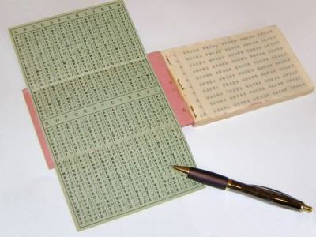
The Substitution Ciphers
The Vernam Cipher (One time pad)

Slide 23
The Substitution Ciphers
The Vernam Cipher (One time pad)
a | b | c | d | e | f | g | h | i | j | k | l | m | n | o | p | q | r | s | t | u | v | w | x | y | z
0 | 1 | 2 | 3 | 4 | 5 | 6 | 7 | 8 | 9 | 10 | 11 | 12 | 13 | 14 | 15 | 16 | 17 | 18 | 19 | 20 | 21 | 22 | 23 | 24 | 25
Plaintext | r | a | m | s | w | a | m | i
PN | 17 | 0 | 12 | 18 | 22 | 0 | 12 | 8
Key | r | a | n | g | e | e | l | a
KN | 17 | 0 | 13 | 6 | 4 | 4 | 11 | 0
J=PN+KN | 34 | 0 | 25 | 24 | 26 | 4 | 23 | 8
Add -26, If J>25 | -26 |  |  |  | -26
Result | 8 | 0 | 25 | 24 | 0 | 4 | 23 | 8
Ciphertext | I | A | Z | Y | A | E | X | I

Slide 24
The Substitution Ciphers
The Vernam Cipher (One time pad)
a | b | c | d | e | f | g | h | i | j | k | l | m | n | o | p | q | r | s | t | u | v | w | x | y | z
0 | 1 | 2 | 3 | 4 | 5 | 6 | 7 | 8 | 9 | 10 | 11 | 12 | 13 | 14 | 15 | 16 | 17 | 18 | 19 | 20 | 21 | 22 | 23 | 24 | 25
Ciphertext | I | A | Z | Y | A | E | X | I
CN | 8 | 0 | 25 | 24 | 0 | 4 | 23 | 8
Key | r | a | n | g | e | e | l | a
KN | 17 | 0 | 13 | 6 | 4 | 4 | 11 | 0
J=CN-KN | -9 | 0 | 12 | 18 | -4 | 0 | 12 | 8
Add 26, If J<0 | 26 |  |  |  | 26
Result | 17 | 0 | 12 | 18 | 22 | 0 | 12 | 8
Plaintext | r | a | m | s | w | a | m | i

Slide 25
Questions ?

